Slide 1
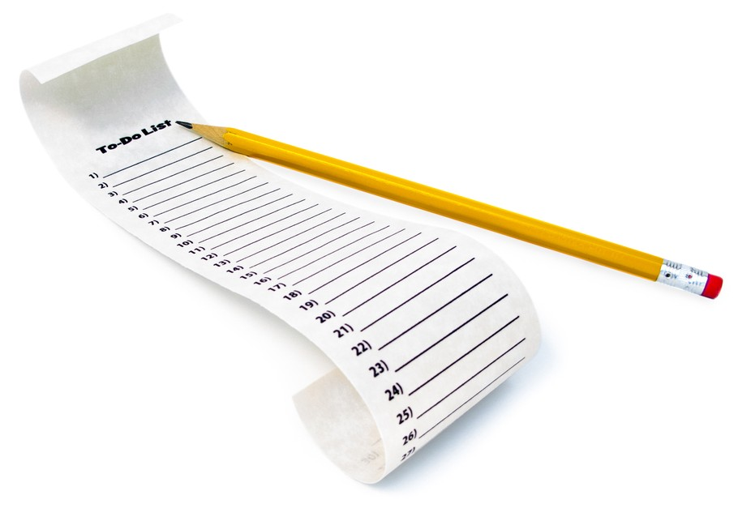
ListViews and Adapters
CIS 399

Slide 2
Course Overview
Wk | Topic
1 | Intro, single-screen apps
1 | Activity Lifecycle, saving activity state
2 | Layouts + widgets, Event Handlers
2 | Themes + styles, Menu + settings
2 | Multi-screen apps, Fragments
Wk | Topic
3 | Reading XML files, Asynch Tasks
3 | List Views
3 | SQLite Database
4 | Consuming a web service
4 | Geolocation

Slide 3

ListViews
Notes:
https://developer.android.com/guide/topics/ui/layout/listview.html

Slide 4
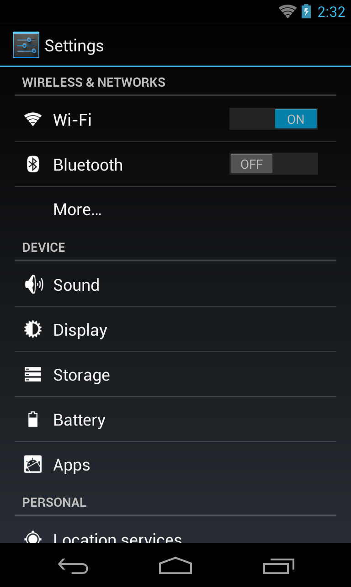
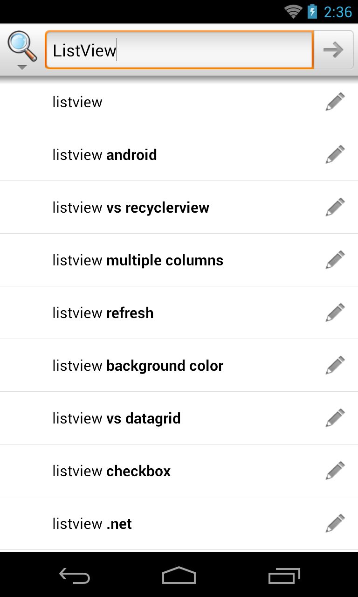
Examples of ListViews

Slide 5
Using a ListView
ListView is a subclass of ViewGroup and can be declared in an XML layout like other UI elements.
The ListView displays a list of scrollable rows.
Each row is a View and it’s layout can be defined in an XML layout.
An Adapter object inserts Items into the ListView. Either pre-defined adapters or custom adapters can be used.

Slide 6
ListView Row Layout
Can be a pre-defined from R.layout, like:
simple_list_item_1
two_line_list_item
See more here: https://developer.android.com/reference/android/R.layout.html
Can be a custom XML layout you define
Notes:
https://developer.android.com/reference/android/R.layout.html

Slide 7
ListActivity
The ListActivity hosts a ListView object
Screen Layout
A single, full-screen list in the center of the screen.
Customize the layout by setting your own XML layout with setContentView() in onCreate()
Row Layout
The constructor for the ListAdapter hosted by the activity has a parameter for a layout resource
The layout resource can be a standard row layout defined in the R.layout class, or a custom XML layout.
Binding to Data
bind the ListActivity's ListView object to data using a class that implements the ListAdapter interface
Two standard list adapters:
SimpleAdapter for static data (Maps)
SimpleCursorAdapter for Cursor query results
Notes:
https://developer.android.com/reference/android/app/ListActivity.html
Note: the screen layout view and the row layout views could also be created programmatically instead of being defined in XML

Slide 8
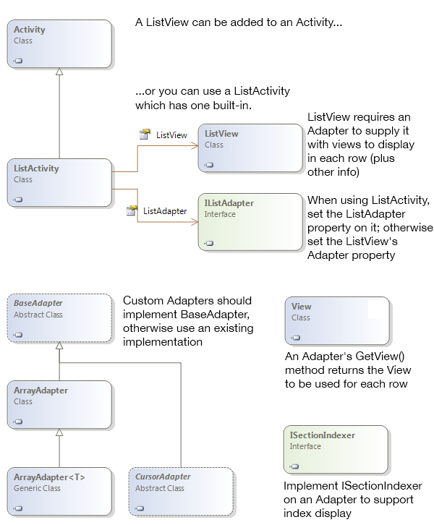
ListActivity Class Diagram

Slide 10
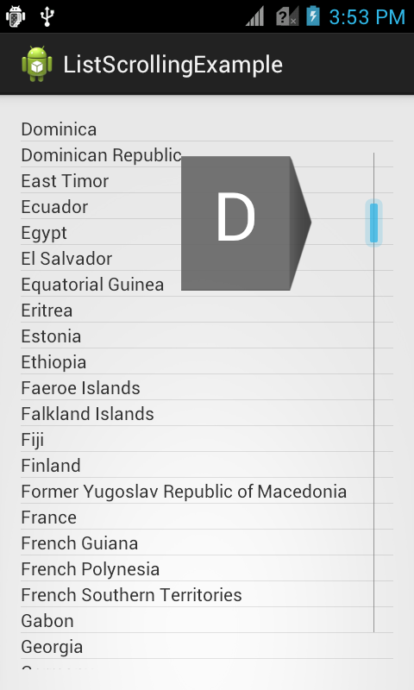
More ListView Features
Fast Scrolling
Dragging a scroll traverses the list
Customizable in API 11 and higher
https://developer.android.com/reference/android/R.attr.html#fastScrollEnabled
Section Index
Section titles appear while scrolling
https://developer.android.com/reference/android/widget/SectionIndexer.htm
Notes:
Reference: https://developer.android.com/reference/android/R.attr.html#fastScrollEnabled
Tutorial: http://androidopentutorials.com/android-listview-fastscroll

Slide 11
Code Tour
Open the Ch. 10 RSS Feed Reader App
In the activity_items layout, look at the ListView XML element.
Look at listview_item layout to see the layout used for the rows in the ListView
Look at the onItemClick event handler

Slide 14
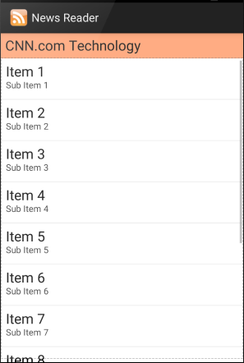
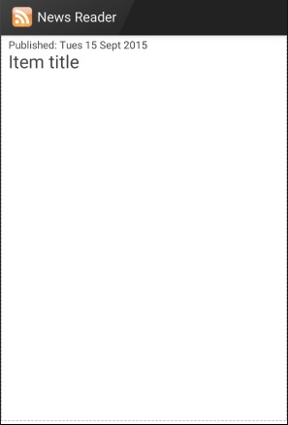

Slide 16
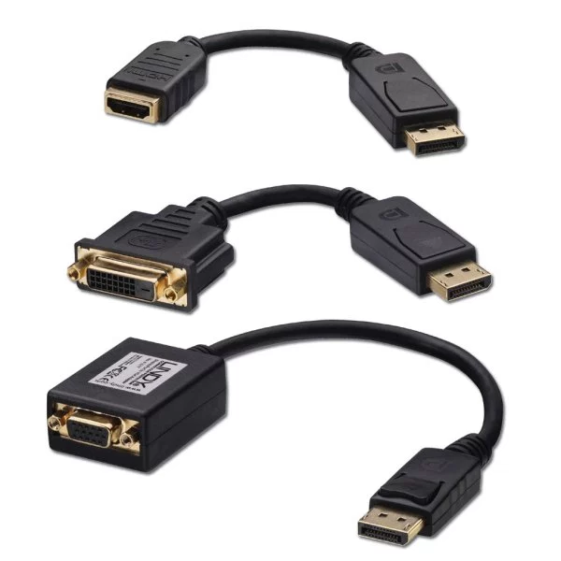
Adapters
Notes:
https://developer.android.com/reference/android/widget/Adapter.html

Slide 17
Adapters
Adapters bind a data source to a ListView
SimpleAdapter – source is a List of JavaDictionary objects
ArrayAdapter<T> – source is an array of type T
SimpleCursorAdapter – source is a SQLite query
BaseAdapter – subclass this to make your own

Slide 18
Adapters
Notes:
Doesn’t show SimpleAdapter, but SimpleAdapter extends BaseAdapter and should be shown here.
The Java version’s indexer is named without the I, just SectionIndexer
https://developer.android.com/reference/android/widget/SectionIndexer.html

Slide 19
Using a SimpleAdapter
Can be used with an ArrayList of Maps
Each entry in the ArrayList corresponds to one row in the list
The Maps contain the data for each row
In the activity’s OnCreate method, instantiate a SimpleAdapter object.
Notes:
Android Developers API documentation: https://developer.android.com/reference/android/widget/SimpleAdapter.html

Slide 20
SimpleAdapter Constructor
public SimpleAdapter (Context context,
List<? extends Map<String, ?>> data,
Int32 resource, String[] from, Int[] to)
context: The host Activity context
data: A List of Map<string, ?> objects
resource: ListView layout from Android.Resource.Layout
from: Map key for data source
to: ListView widget property for displaying data
Notes:
https://developer.android.com/reference/android/widget/SimpleAdapter.html#SimpleAdapter(android.content.Context, java.util.List<? extends java.util.Map<java.lang.String, ?>>, int, java.lang.String[], int[])

Slide 21
Code Tour
Open the Ch. 10 RSS Feed Reader App
In the ItemsActivity class, look at the code that creates and sets the adapter.

Slide 23
Further ListView Reading
Using lists in Android (ListView) – Tutorial
by Lars Vogel, 9/29/2015
http://www.vogella.com/tutorials/AndroidListView/article.html#arrayAdapter
Fast scroll and Section indexer tutorial
http://androidopentutorials.com/android-listview-fastscroll
Android Developers ListView Guide
https://developer.android.com/guide/topics/ui/layout/listview.html

